Slide 1
Multiple Source Optimal Power Flow
Aryan Ritwajeet Jha
Pursuing PhD ECE (Power Systems)
Washington State University
Notes:
Remember to hit the reset button to make sure all the page elements react properly.
There are 20 different layouts that you can choose from.

Slide 2
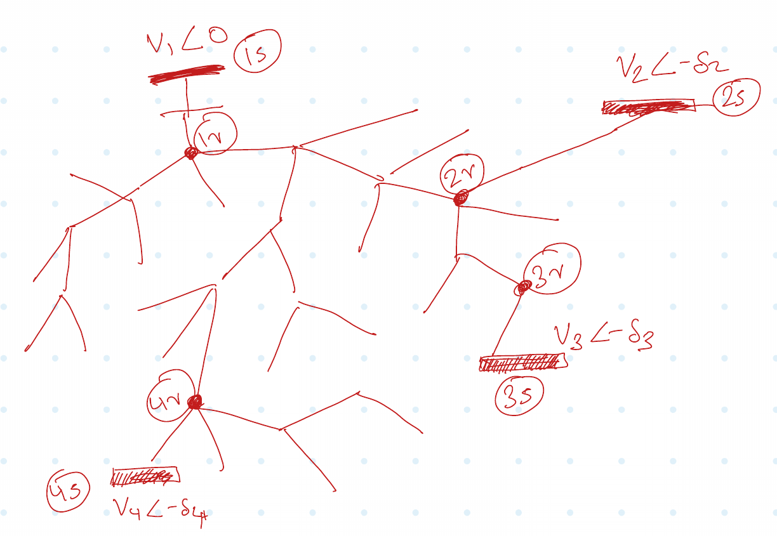
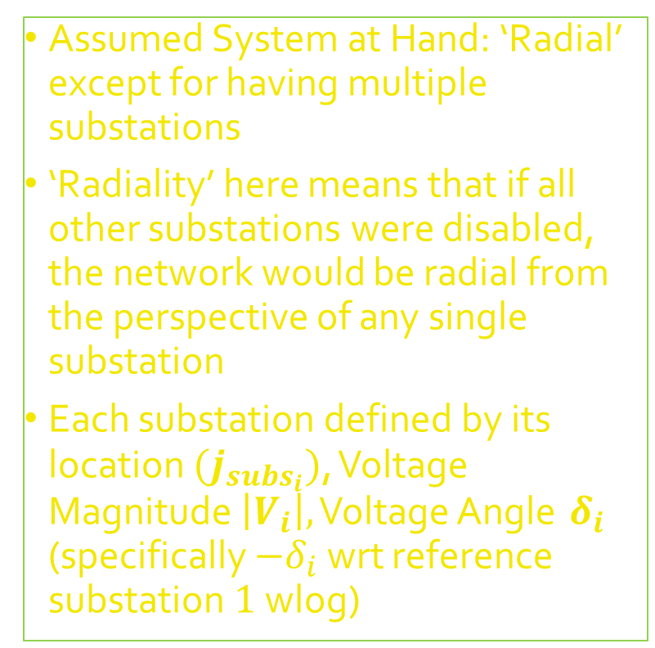
Assumed System at Hand: ‘Radial’ except for having multiple substations
‘Radiality’ here means that if all other substations were disabled, the network would be radial from the perspective of any single substation
Each substation defined by its location $(j_{subs_{i}})$, Voltage Magnitude $\left|V_{i}\right|,$ Voltage Angle ${ δ}_{i}$ (specifically $−δ_{i}$ wrt reference substation $1$ wlog)

Slide 3
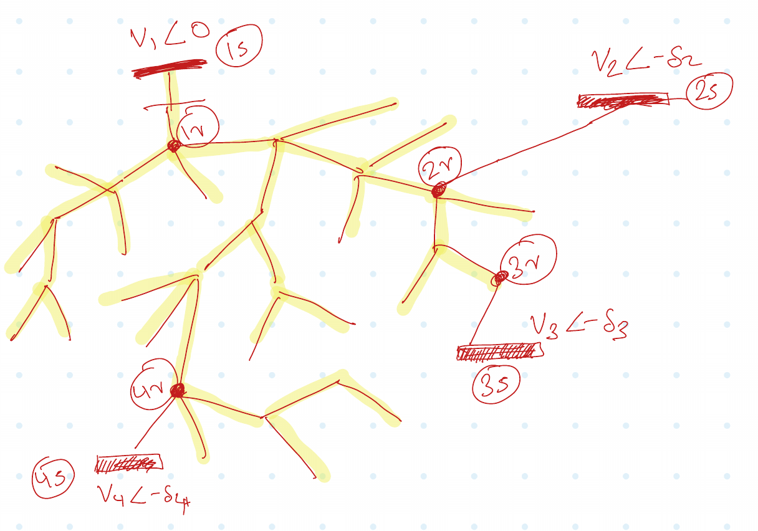
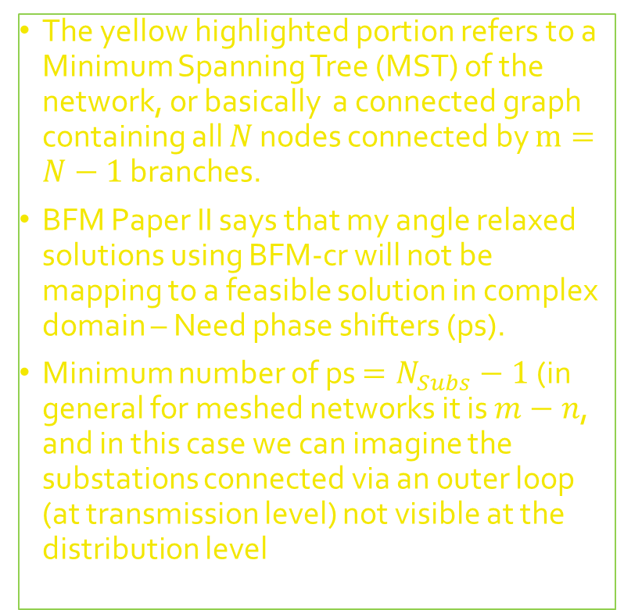
The yellow highlighted portion refers to a Minimum Spanning Tree (MST) of the network, or basically a connected graph containing all $N$ nodes connected by $m=N−1$ branches.
BFM Paper II says that my angle relaxed solutions using BFM-cr will not be mapping to a feasible solution in complex domain – Need phase shifters (ps).
Minimum number of ps $=N_{Subs}−1$ (in general for meshed networks it is $m−n$, and in this case we can imagine the substations connected via an outer loop (at transmission level) not visible at the distribution level

Slide 4
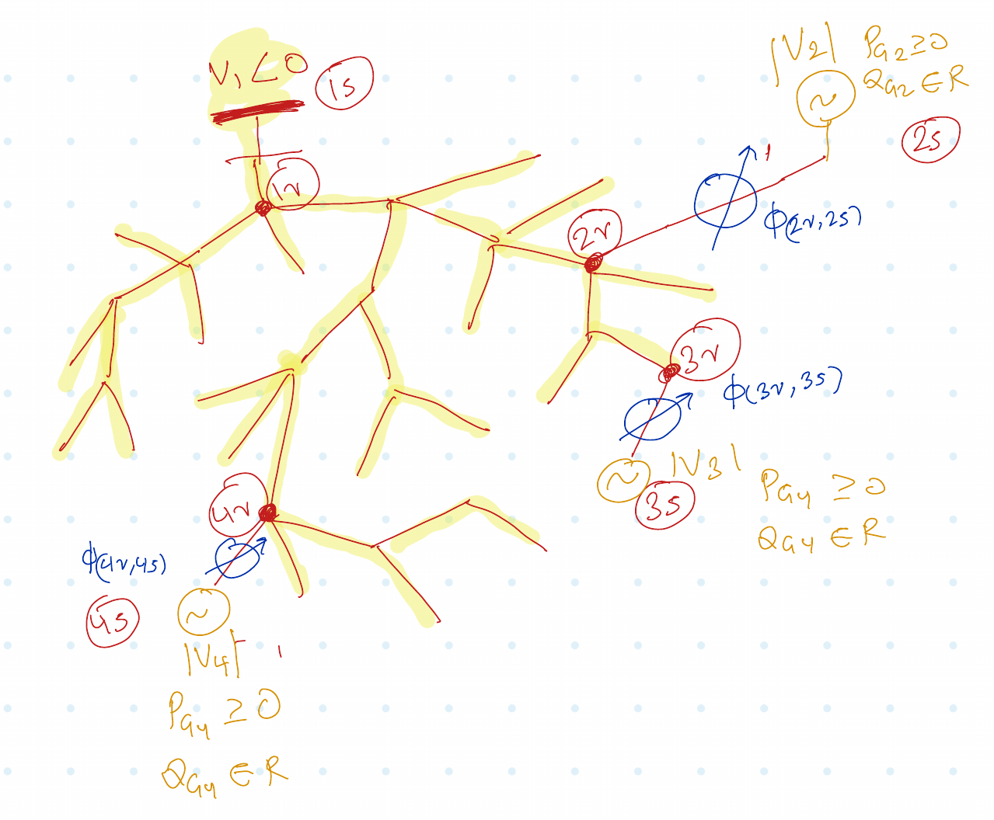
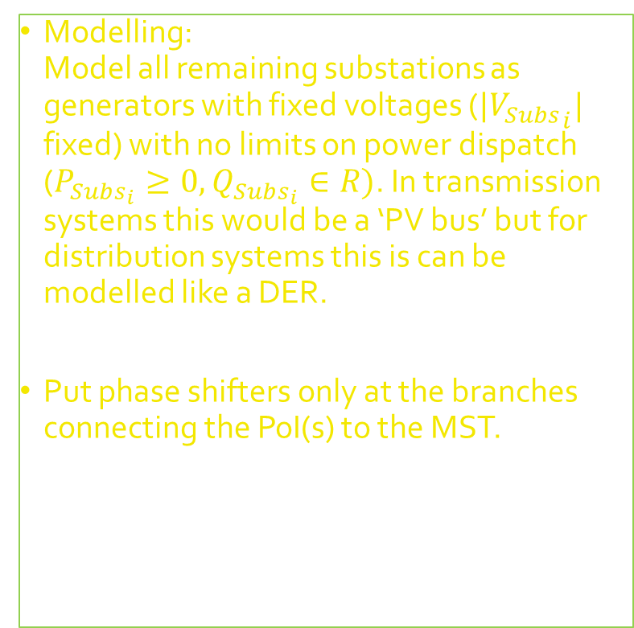
Modelling: Model all remaining substations as generators with fixed voltages (${{|V}_{Subs}}_{i}|$ fixed) with no limits on power dispatch ($P_{Subs_{i}}≥0, Q_{Subs_{i}}∈R)$. In transmission systems this would be a ‘PV bus’ but for distribution systems this is can be modelled like a DER.
Put phase shifters only at the branches connecting the PoI(s) to the MST.

Slide 5

Latest slides here. Previous slides may follow.

Slide 6
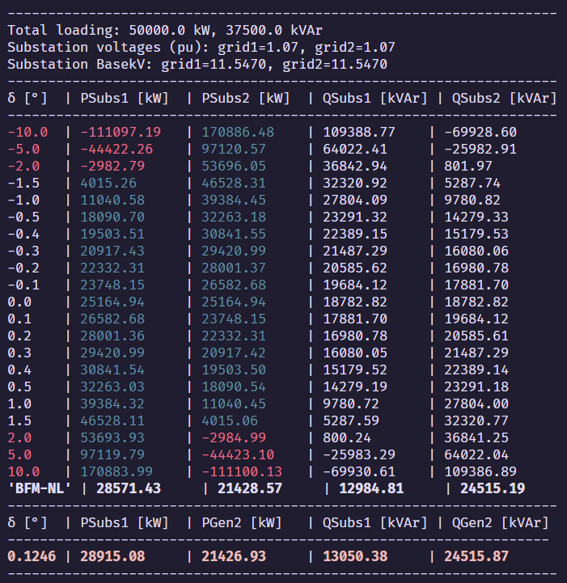
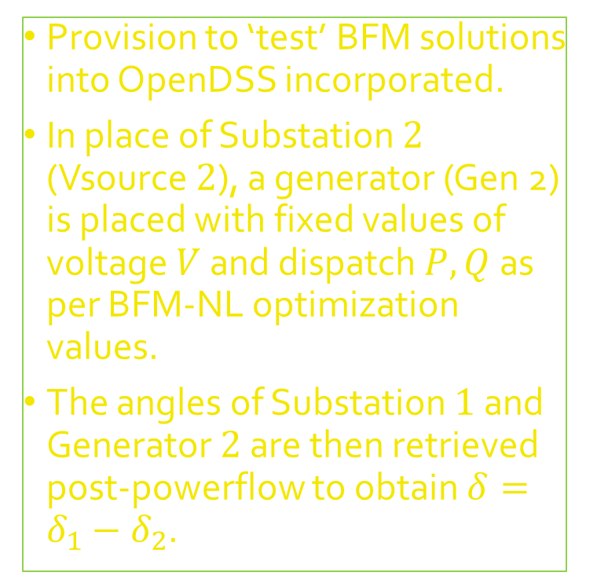
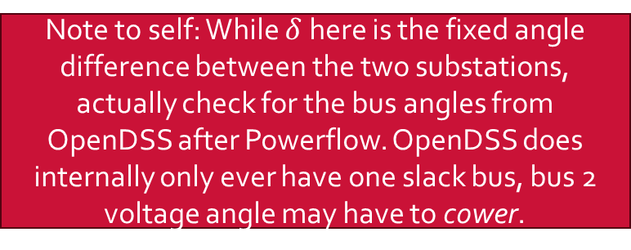
Provision to ‘test’ BFM solutions into OpenDSS incorporated.
In place of Substation $2$ (Vsource $2$), a generator (Gen 2) is placed with fixed values of voltage $V$ and dispatch $P, Q$ as per BFM-NL optimization values.
The angles of Substation $1$ and Generator $2$ are then retrieved post-powerflow to obtain $δ=δ_{1}−δ_{2}$.
Note to self: While $δ$ here is the fixed angle difference between the two substations, actually check for the bus angles from OpenDSS after Powerflow. OpenDSS does internally only ever have one slack bus, bus 2 voltage angle may have to cower.

Slide 7
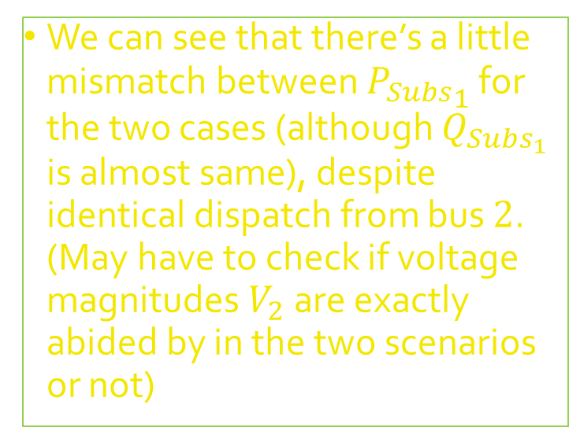

We can see that there’s a little mismatch between ${P_{Subs}}_{1}$ for the two cases (although $Q_{Subs_{1}}$ is almost same), despite identical dispatch from bus $2$. (May have to check if voltage magnitudes $V_{2}$ are exactly abided by in the two scenarios or not)
From BFM-NL optimization: Angle constraints relaxed, solution angle unknown
OpenDSS simulation where Substation 2 is converted a Generator with same values of $P, Q, V$ as BFM-NL

Slide 8
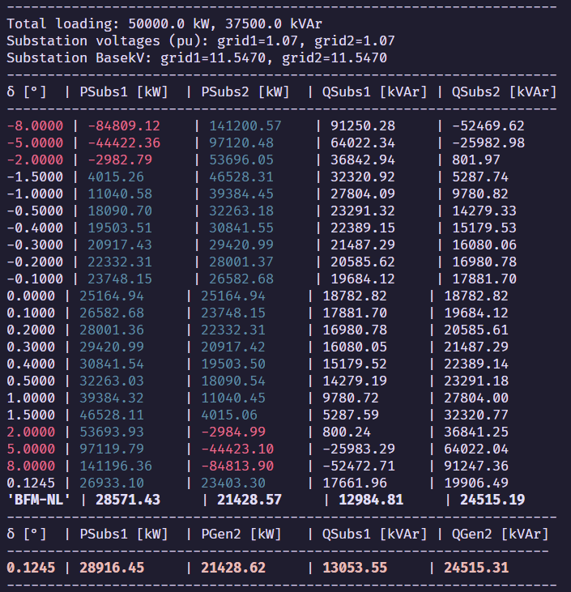
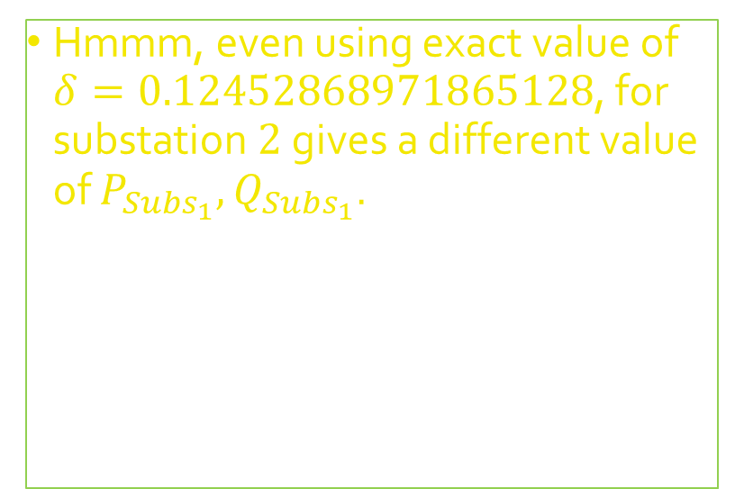

Hmmm, even using exact value of $δ=0.12452868971865128$, for substation $2$ gives a different value of $P_{Subs_{1}},Q_{Subs_{1}}$.
OpenDSS simulation where Substation $2$ has been assigned the angle from the Generator $2$ simulation
OpenDSS simulation where Substation 2 is converted a Generator with same values of $P, Q, V$ as BFM-NL

Slide 9
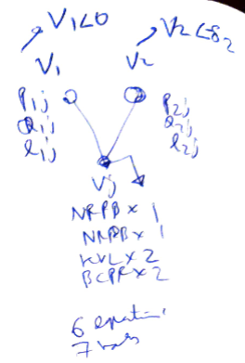
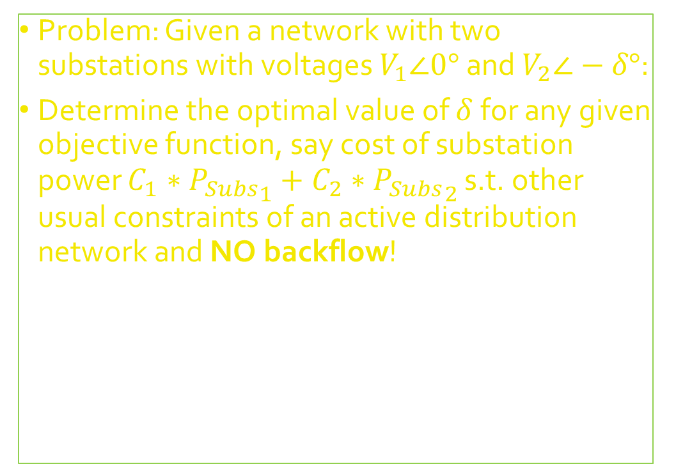

Multiple Sources = $2$ Substations* Network = $2$ Substations + $2$ Branches + $1$ Load* (*for now..)
Problem: Given a network with two substations with voltages $V_{1}∠0°$ and $V_{2}∠−δ°$:
Determine the optimal value of $δ$ for any given objective function, say cost of substation power $C_{1}∗{P_{Subs}}_{1}+C_{2}∗{P_{Subs}}_{2}$ s.t. other usual constraints of an active distribution network and NO backflow!

Slide 10
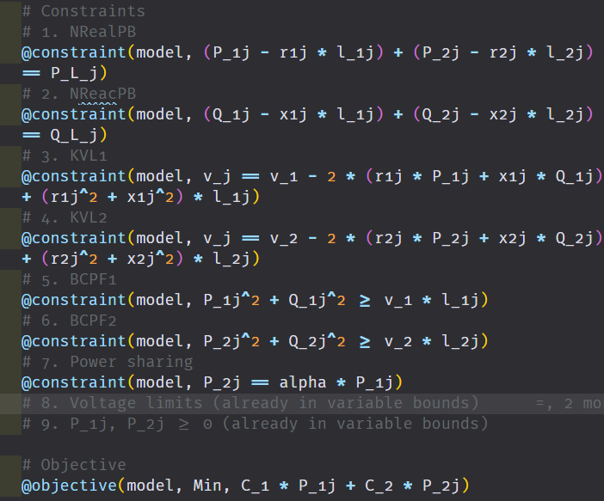
Optimization using BFM-NL
Using Branch Flow Model (Nonlinear) I can optimize for the optimal power flow of the network – note that BFM does not take into consideration (relative) voltage angles of the substations.
Is the modelling (and thus the solution) even correct?

Slide 11
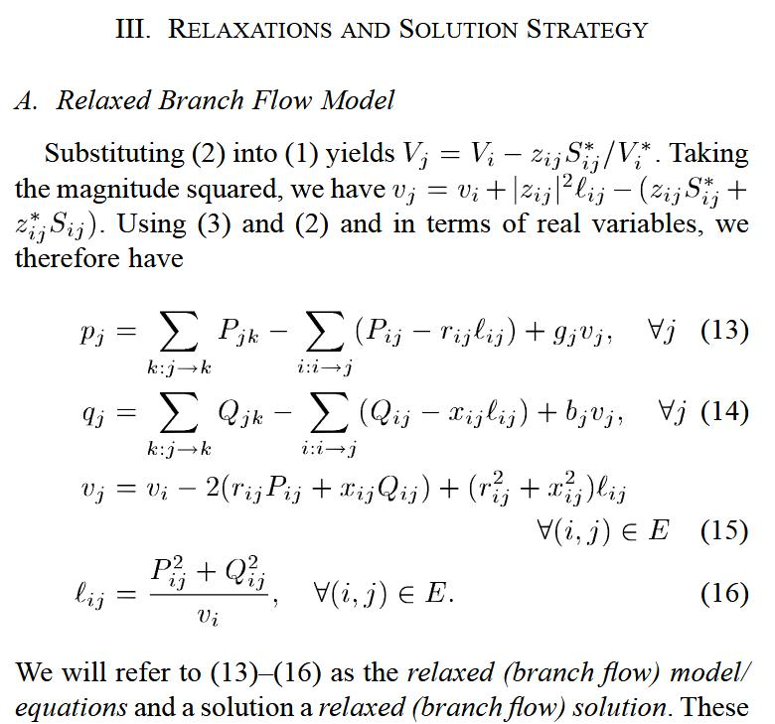
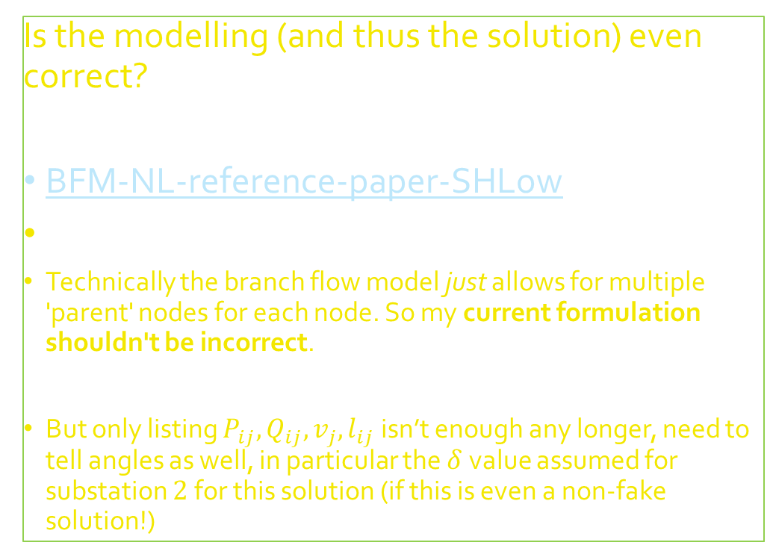
Optimization using BFM-NL
Is the modelling (and thus the solution) even correct?
BFM-NL-reference-paper-SHLow
Technically the branch flow model just allows for multiple 'parent' nodes for each node. So my current formulation shouldn't be incorrect.
But only listing $P_{ij}, Q_{ij}, v_{j}, l_{ij}$ isn’t enough any longer, need to tell angles as well, in particular the $δ$ value assumed for substation $2$ for this solution (if this is even a non-fake solution!)

Slide 12
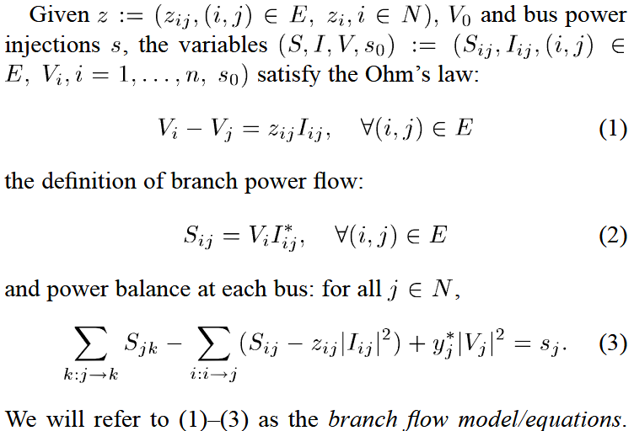
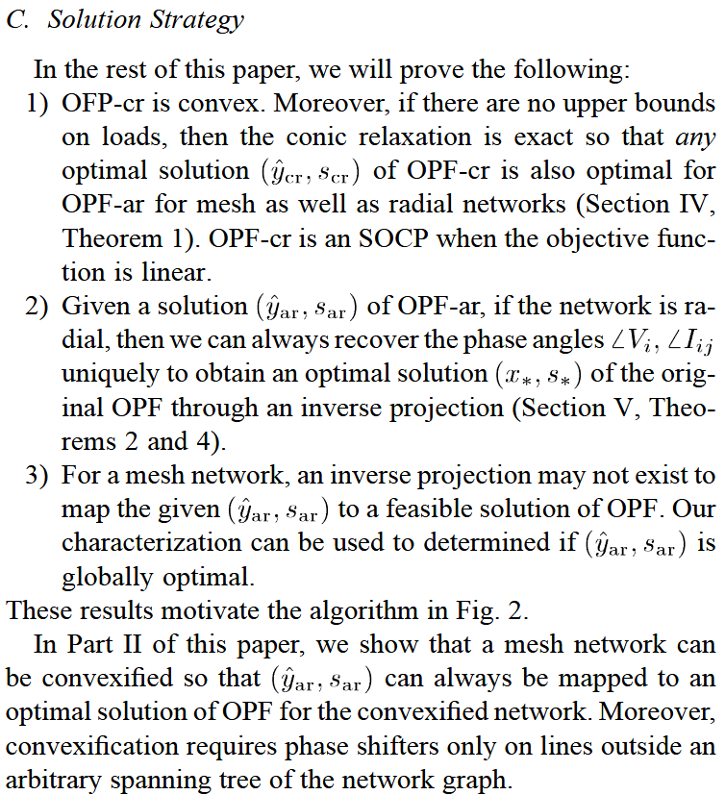
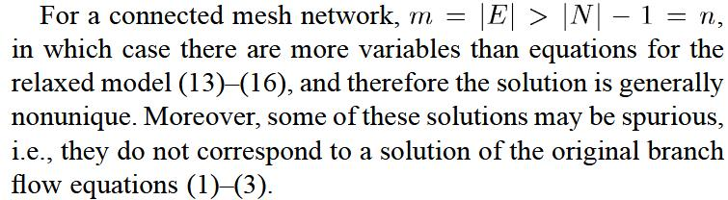
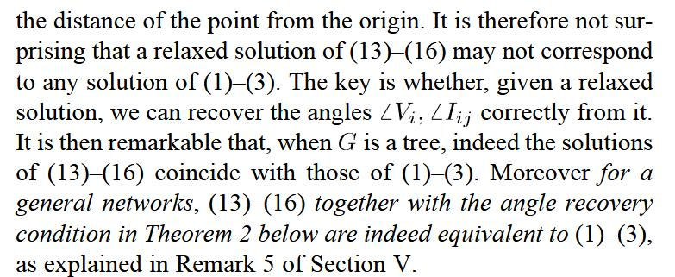
Optimization using BFM-NL
It looks like I need to study part II of the paper to understand the angle recovery process – nonunique and nontrivial for ‘meshed’ systems

Slide 13
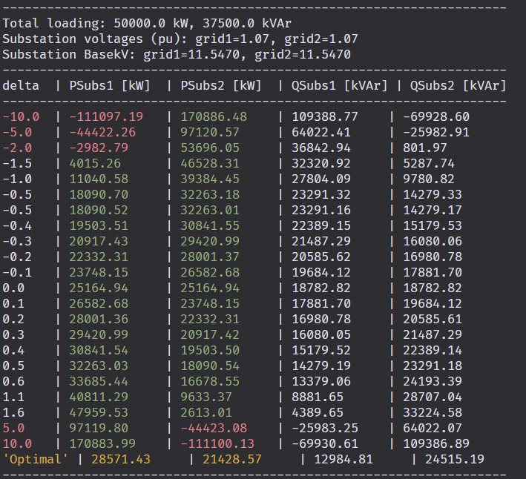

Meanwhile I’ve created the same system in OpenDSS where I am running powerflows for different values for $δ$ – it does look like our solution should have a feasible value associated with it.

Slide 14
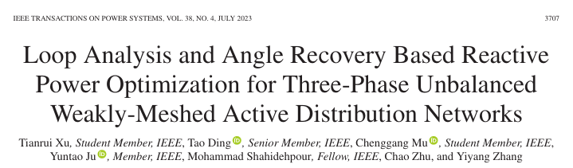

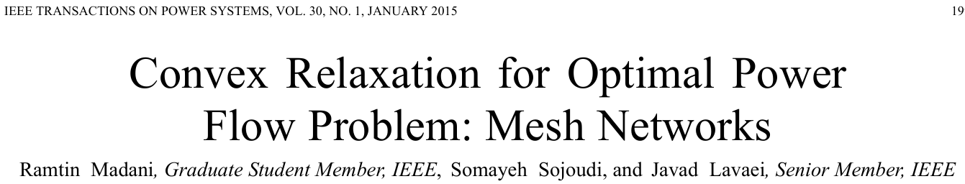
Given some papers by Subho to read

